Slide 1
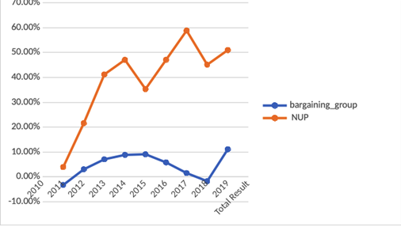
Figure 2: SSU percentage growth - employees per group

Slide 2
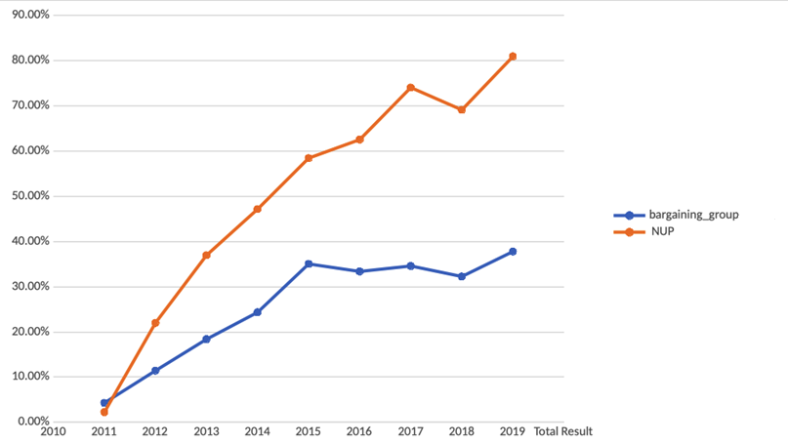
Figure 2: SSU percentage growth – salary spend per group

Slide 3
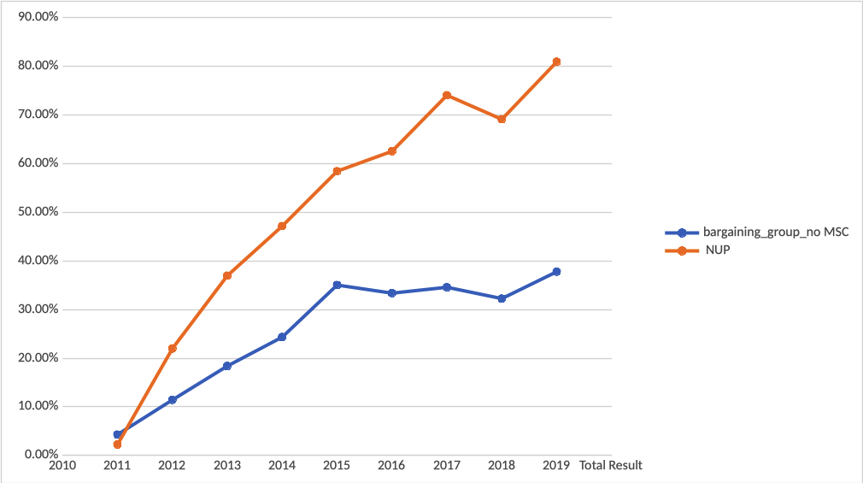
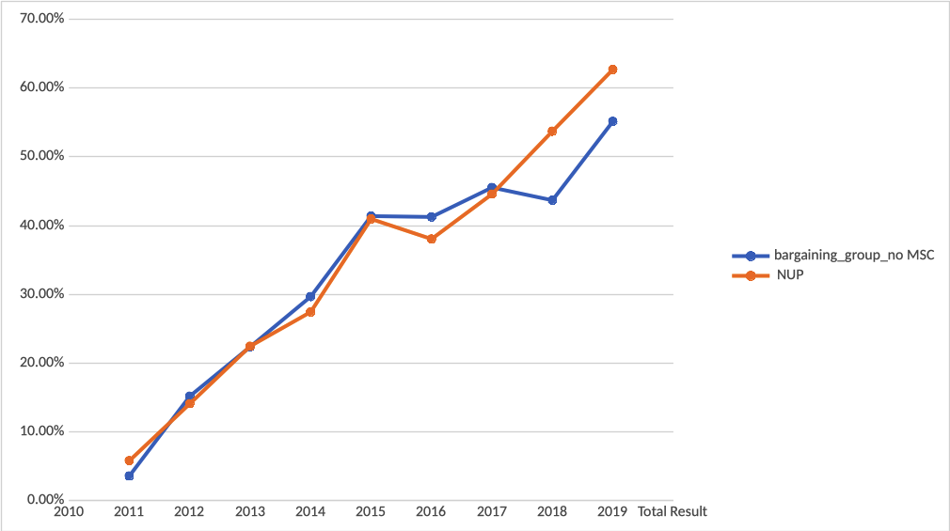
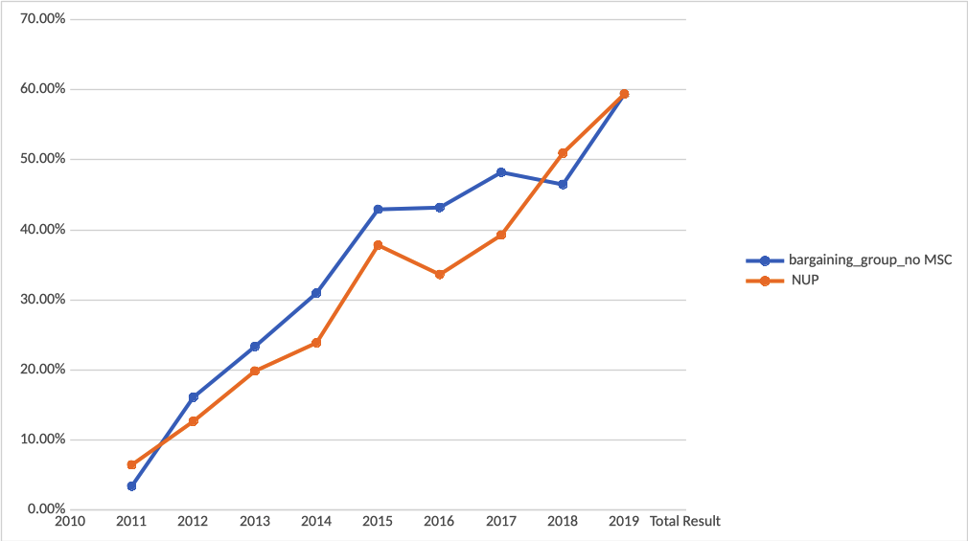
percentage growth – salary spend per group
SSU
All 9 MSCA schools
MSCA schools except SSU

Slide 4
Data taken from: https://cthru.data.socrata.com/dataset/Commonwealth-Of-Massachusetts-Payrollv2/rxhc-k6iz/data

